Slide 1
RATHINAM
CENTRE OF EXCELLENCE
DataBase Management System
Indexing
Mrs.B.Sharmila
Technical Trainer

Slide 2
RATHINAM
CENTRE OF EXCELLENCE
Database Management System
Indexing

Slide 3
Indexing
Indexing is defined as a data structure technique which allows you to quickly retrieve records from a database file.
It is based on the same attributes on which the indices has been done.
An index,
Takes a search key as input
Efficiently returns a collection of matching records.
Notes:
Examples : Images, Text, videos etc.

Slide 4
Indexing
An Index is a small table having only two columns.
The first column comprises a copy of the primary or candidate key of a table.
The second column contains a set of pointers for holding the address of the disk block where that specific key value stored.

Slide 5
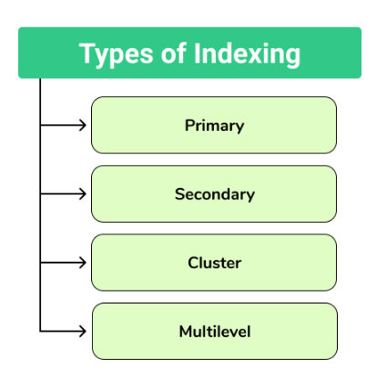
Types of Indexing

Slide 6
Primary Indexing
Primary Index is an ordered file which has fixed length size with two fields.
The first field is the same a primary key and second field is pointed to that specific data block.
In the primary index, there is always one to one relationship between the entries in the index table.
Primary Indexing is further divided into two types.
Dense Index
Sparse Index

Slide 7
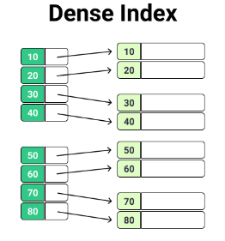
Dense Index
In a dense index, a record is created for every search key valued in the database.
Dense indexing helps you to search faster but needs more space to store index records.
In dense indexing, records contain search key value and points to the real record on the disk.

Slide 8
Sparse Index
The sparse index is an index record that appears for only some of the values in the file.
Sparse Index helps you to resolve the issues of dense indexing.
In sparse indexing technique, a range of index columns stores the same data block address, and when data needs to be retrieved, this block address will be fetched.
Sparse indexing method stores index records for only some search key values.
It needs less space, less maintenance overhead for insertion, and deletions but it is slower compared to the dense index for locating records.

Slide 9
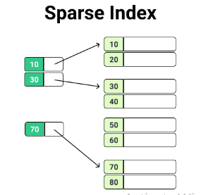
Sparse Index

Slide 10
Secondary Indexing
The secondary index can be generated by a field which has a unique value for each record.
It is also known as a non-clustering index.
This two-level database indexing technique is used to reduce the mapping size of the first level.
For the first level, a large range of numbers is selected, because of this mapping size always remains small.

Slide 11
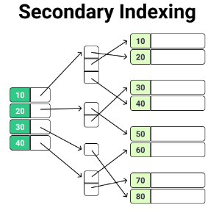
Example Secondary Indexing
In a bank account database, data is stored sequentially by Account_No, we may want to find all accounts in of a specific branch of some bank.
In this case, we can have a secondary index for every search key.
Index record is a record pointing to a bucket that contains pointers to all the records with their specific search key value.

Slide 12
Cluster Indexing
In a clustered index, records themselves are stored in the index and not pointers.
Sometimes the index is created on non-primary key columns which might not be unique for each record. In such a situation, you can group two or more columns to get the unique values and create an index which is called clustered Index.
This also helps you to identify the record faster.
Example
Consider a company recruited many employees in various departments. In this case, clustering index should be created for all employees who belong to the same dept.
In a single cluster it is considered that an index points to the cluster as a whole.

Slide 13
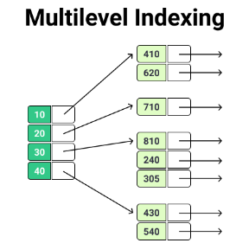
Multilevel Indexing
Multilevel Indexing is created when a primary index does not fit in memory.
In this type of indexing method, you can reduce the number of disk accesses to short any record and kept on a disk as a sequential file and create a sparse base on that file.

Slide 14
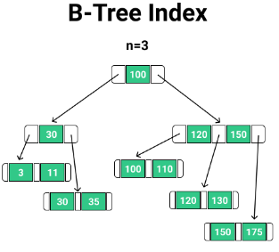
B-treeIndexing
B-tree index is the widely used data structures for indexing.
It is a multilevel index format technique which is balanced binary search trees.
All leaf nodes of the B tree signify actual data pointers.
In B-Tree indexing, all leaf nodes are interlinked with a link list, which allows a it to support both random and sequential access.

Slide 15
Properties of B-tree
Every path from the root to leaf are mostly of equal length.
Every node which is not a root or a leaf has between n/2 and n children, where n is the degree of B-tree.

Slide 16
Advantages of Indexing
It helps you to reduce the total number of I/O operations needed to retrieve the data, so you don’t need to access a row in the database from an index structure.
Offers faster search and retrieval of data to users.
Indexing also helps you to reduce table space as you don’t need to link to a row in a table, as there is no need to store the ROWID in the Index. Thus you will able to reduce the table space.
You don’t need to sort data in the lead nodes as the value of the primary key classifies it.

Slide 17
Disadvantages of Indexing
To perform the indexing database management system, you need a primary key on the table with a unique value.
You are not allowed to partition an index-organized table.
SQL indexing decrease performance in INSERT, DELETE, and UPDATE query.

